Slide 1
3D Model Structural Viability Assistant
Gabriel Donnan
Notes:
I am Gabriel Donnan and welcome to my demonstration of progress presentation for my 3D model structural viability assistant.

Slide 2

Agenda
Rationale
State of the Art
Methods + Results
Future Plans
Notes:
For the agenda I will be covering the projects’ rationale, the current state of the art of the field, my methods and results and future plans

Slide 3

Rationale
Project Goal:
Create a software extension to the 3D modelling software, Blender which allows for material and balance analysis of how objects would behave in real life.
Why?:
- Blender does not currently have a method of model analysis, despite a normally rich feature suite.
- This tool would mean anyone can see how their model would behave free of charge without need for AutoCAD experience
- Current options for similar software only exist in the price range of £5000+ per annum*.
* https://autofem.com/en/prices-of-autofem-products.html
Notes:
Rationale
The project goal is to build a 3D model analysis software, analysing both structural integrity and balance of 3D objects in blender
This would add much needed missing functionality to blender,
It also means means autocad is no longer the only option for 3d model analysis,
And you no longer have to spend £5000+ per year for a similar software package

Slide 4
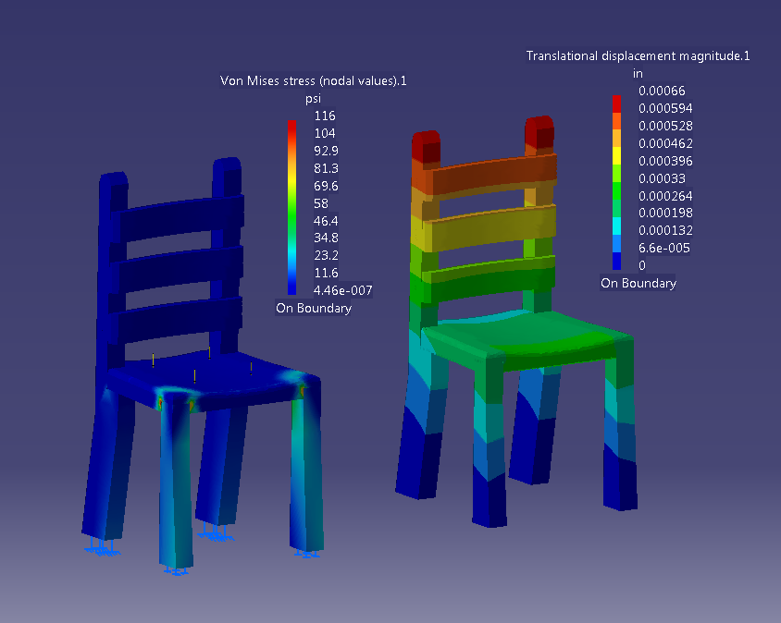
Why 3D Analysis?
- Large scale manufacturing companies use it but why should we?
- Smaller designers or personal use:
> Furniture
> DIY Projects
> More accurate simulations for animation
- Smaller scale designers or builders can save on materials and avoid more accidents with material analysis.
http://kevanelliscatiaportfolio.weebly.com/uploads/5/1/9/2/51924425/9995081_orig.png
Notes:
Why 3D analysis?
It is somewhat obvious why manufacturing companies use 3d analysis but I believe it is a useful tool for the general public as well
Can be used for smaller scale designers (groups of 1 or 2 people), diy projects and accurate material simulation for animation
If you find out model does not need some areas of reinforcement as a small designer can greatly save on material cost

Slide 5

State of the Art
- Finite element analysis the overwhelming technique used
> Companies like Autodesk, SimScale, etc.
- Finite Element Method:
> Computational model to approximate partial differential equations
> Discretizes a mesh into simple shapes, i.e. “elements”. Then numerically solves equations with said shapes.
- No major scale applications perform moment or balance analysis
Notes:
State of the Art
Major companies all use finite element analysis which is based off the Finite element method.
The FEM is a way computers can find approximate solutions to partial differential equations, which 3d meshes can conveniently be broken down to form.
No major scale applications perform balance analysis which my program will.

Slide 6
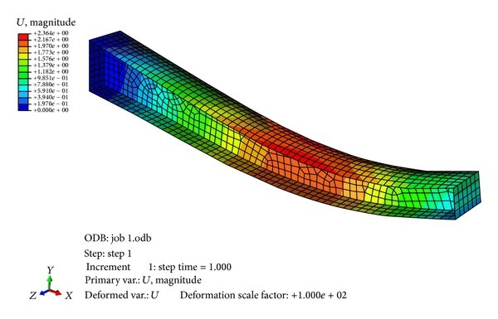
Finite Element Analysis Contd.
- How does finite element analysis work?
> Model split into finite elements
> Finite elements iterated over
> For each element Stiffness Matrix* found
> With some math from here we can then find displacement + forces applied
> This can be done with 1, 2 or 3 dimensional elements depending on our model
https://www.researchgate.net/publication/273180368/figure/fig5/AS:1088632035258371@1636561511281/Finite-element-model-of-tapered-beam.jpg
* Stiffness matrix represents a system of linear equations
to solve for our forces
Notes:
Continuing my explanation of FEM
In finite element analysis models are split into one, two or three dimensional finite elements (edges, faces or cubes normally)
For each element in the system a stiffness matrix representing the equations to solve is formed
Applying some math from here forces and displacement of each element can be found

Slide 7
Development Journey Challenges I faced and prototypes along the way
Prototype different FEM divisions
Sketching out how complex models can be separated into finite elements.
Finding best force application method
Considering most common force application methods:
- How wide of an area is a force going to be applied to - Which vertices are affected by a force application
Prototyping object representation
Manually making crystalline lattices? – Testing in Blender
Automatic crystalline lattices? – Sketching
Colour map to surface? – needs further ray casting
Ray casting? – would create irregular node spacing. Sketching + small low fidelity prototype
How do I represent final forces?
How do I generate the lattices?
No need for lattices if 3D finite elements are used.
Join to n closest nodes? – paper prototyping
Colour each face? – sketch + experiment with blender surfaces
Colour each edge? – easiest method but leaves interpretation to user
Notes:
Development Journey
In order to reach my current iteration of the project I did extensive prototyping. I initially needed to decide between one, two or three dimensional finite elements and settled on one dimensional to minimise computational load
Then in order to find best force application method I tested both application to whole faces, edges and vertices and settled on vertices as it provides greatest precision.
To determine how solid 3d objects would work with 1d finite elements I experimented with automatic lattice generation, both by casting rays into the object and forming new vertices every n steps and by linking multiple meshes together. I settled on the latter for performance reasons.
In order to get the results of our analysis a colour mapping should be used to determine areas of high and low forces. I settled on colouring each edge of the model as this gives a good representation of exactly where a model would fail in 3d space.

Slide 8
Current Methodology
1) Model read in from Blender
2) Model reduced to vertices, edges and faces
2)a) If multiple models exist they are linked together to form one cohesive mesh
3) Nodes each have forces applied to them
4) Each edge is treated as a 1 dimensional finite element (like a thin bar would be)
5) Analysis is performed on the full system (element-wise)
6) Moment and balance analysis performed
Notes:
In the current version of the project:
The model is read in from blender and discretised to its finite elements. Multiple meshes can be linked together to form crystalline lattices as an approximation for solid objects.
Nodal forces are applied
FEM performed on the whole system as are moment and balance analysis to see whether the object will tip over or is well balanced.

Slide 9
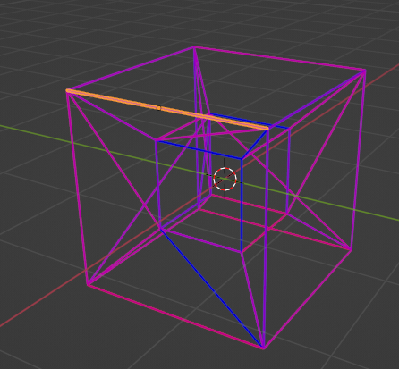
Demonstration of Current Methodology + Results

Slide 10
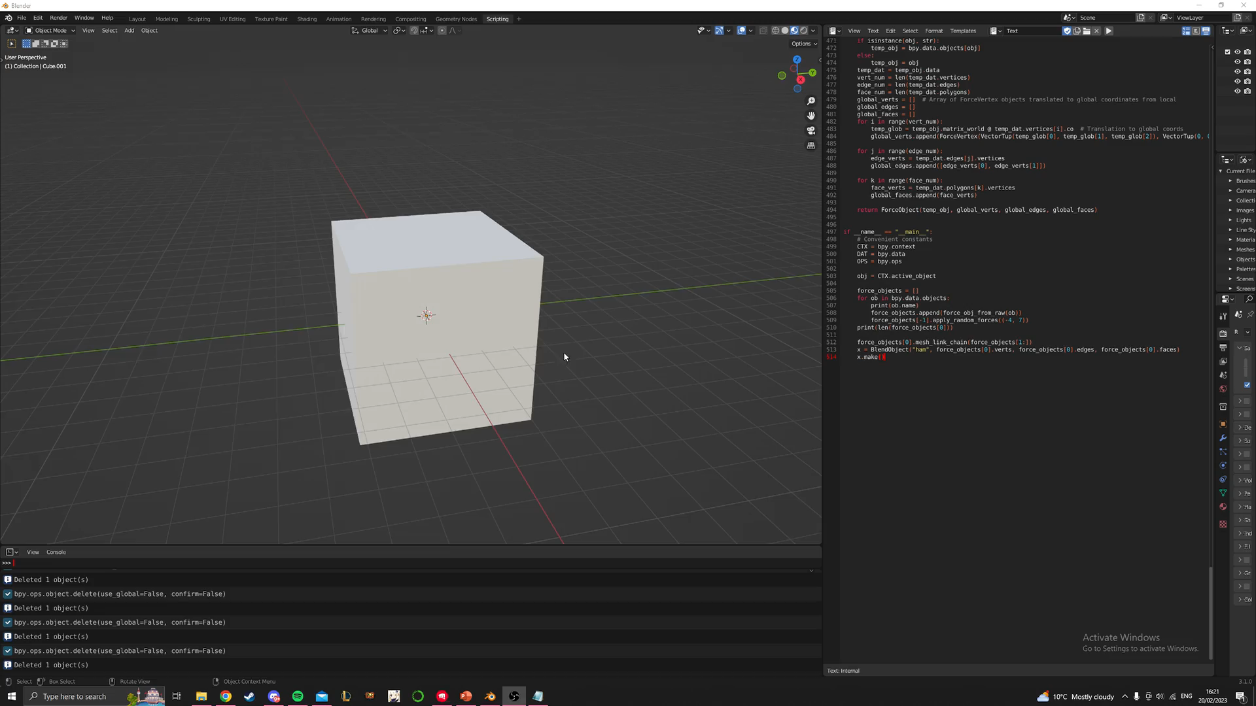
Demonstration
2) Model split into faces, edges + vertices
a) Linking multiple meshes from the n closest vertices
This helps approximate crystalline lattices in more complex objects

Slide 11
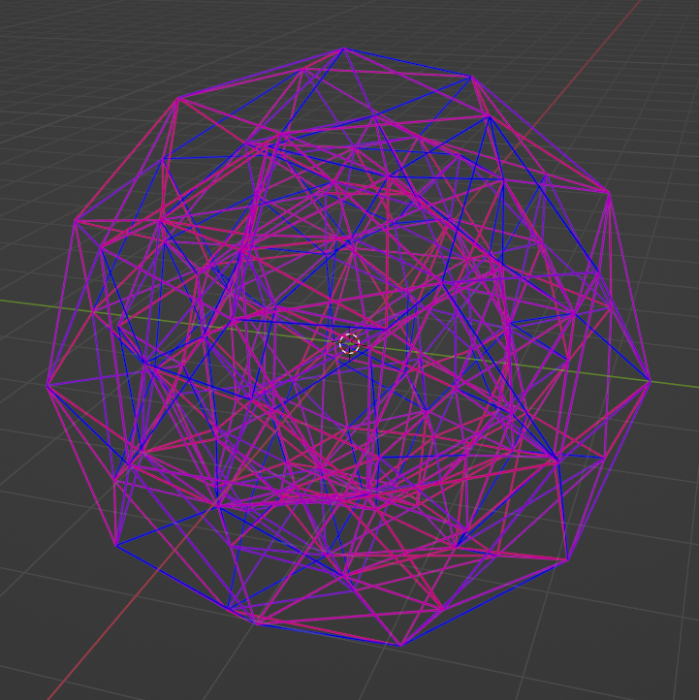
Current Results
Loading of any number of blender models at once
Application of forces
Colouring of finite elements based on given input (easily integrated with FEA)
Linking of any type or number of meshes to form approximations of crystalline lattices
Scalable, elegant and easy to work with programmatic representations of data
Notes:
My current results for the program include:
Loading any amount of blender models at once
Application of forces to any number of vertices
Colouring of my 1d finite elements based on an input I have given which is ready for integration with FEA
Linking of any number or shape of mesh to approximate solid objects
Scalable, easy to work with and elegant code which allows for quick improvement.

Slide 12
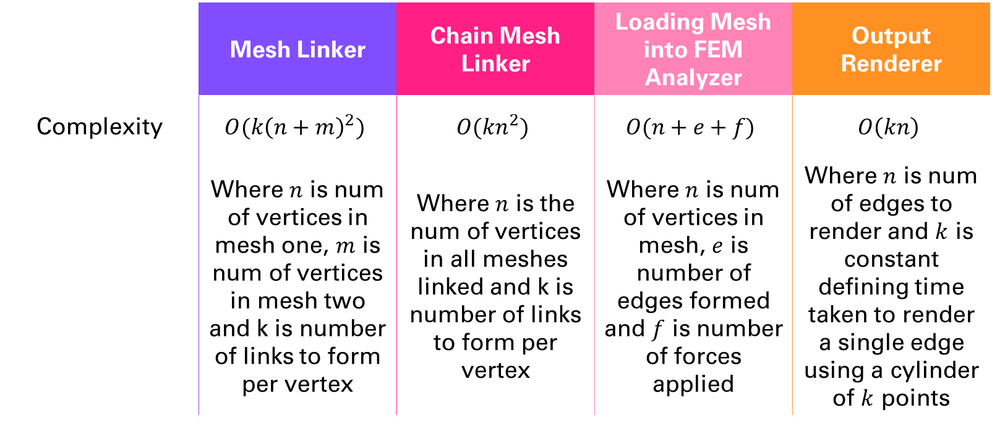
Algorithmic Complexities
 | Mesh Linker | Chain Mesh Linker | Loading Mesh into FEM Analyzer | Output Renderer
Complexity | $$O(k{\left(n+m\right)}^{2})$$ | $$O({kn}^{2})$$ | $$O(n+e+f)$$ | $$O\left(kn\right)$$
 | Where $n$ is num of vertices in mesh one, $m$ is num of vertices in mesh two and k is number of links to form per vertex | Where $n$ is the num of vertices in all meshes linked and k is number of links to form per vertex | Where $n$ is num of vertices in mesh, $e$ is number of edges formed and $f$ is number of forces applied | Where $n$ is num of edges to render and $k$ is constant defining time taken to render a single edge using a cylinder of $k$ points
Notes:
Due to the nature of 3D models and their vertex + edge + face based representation a large amount of data has to be processed for more complicated objects.
Here are the complexity breakdowns for each component of the current main analysis operations.

Slide 13
Development Timeline
Integrate FEM
Integrate finite element analysis portion with current iteration
2D Finite Elements
Add support for two-dimensional finite elements.
Allows for more types of object to be accurately simulated
Materials + Saving
Add support for analysis of different materials
Adding support for saving objects
Balance Analysis
Allow for balance and moment analysis
Possibly allow for display of mesh deformation under imposed loads
Blender Integration
Integration of functionality into Blender’s menu system
Notes:
From my current iteration of the project here are the steps I have to take to reach the finished design:
Integration of the FEM portion with the rendering and loading portion of the program.
Possibly integrating two dimensional finite elements such that more accurate simulations can be performed
Add support for custom materials and saving of models for analysis
Integrating rendering with the balance analysis and possibly allowing for viewing how a mesh would deform.
Integrating the whole program into blender’s menu system instead of its scripting section. This is purely for quality of life.

Slide 14



Any Questions?
Gabriel Donnan
gd517@bath.ac.uk

